Slide 1
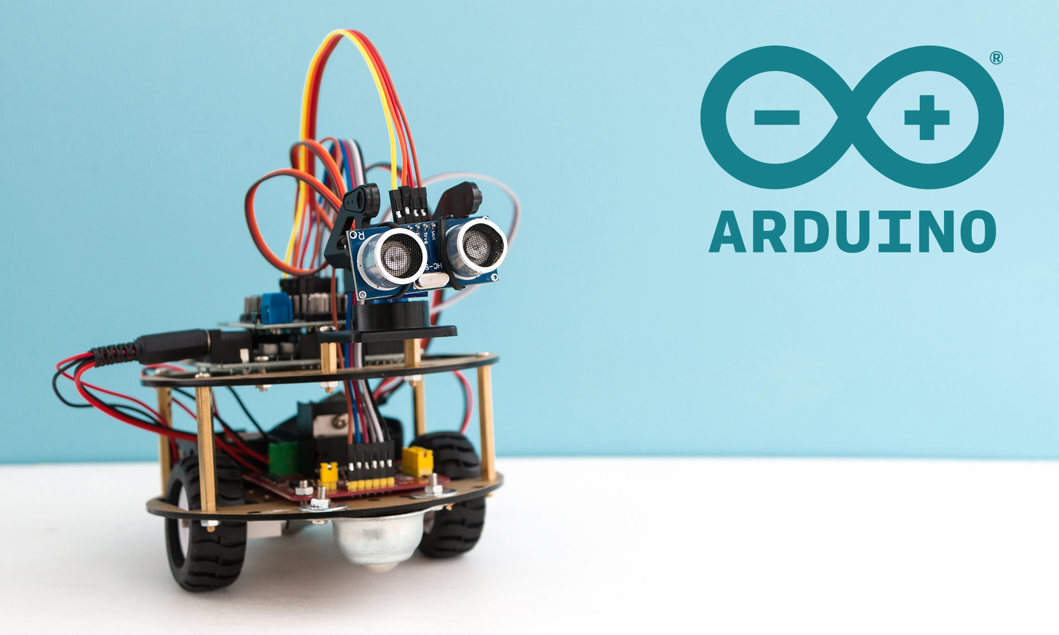
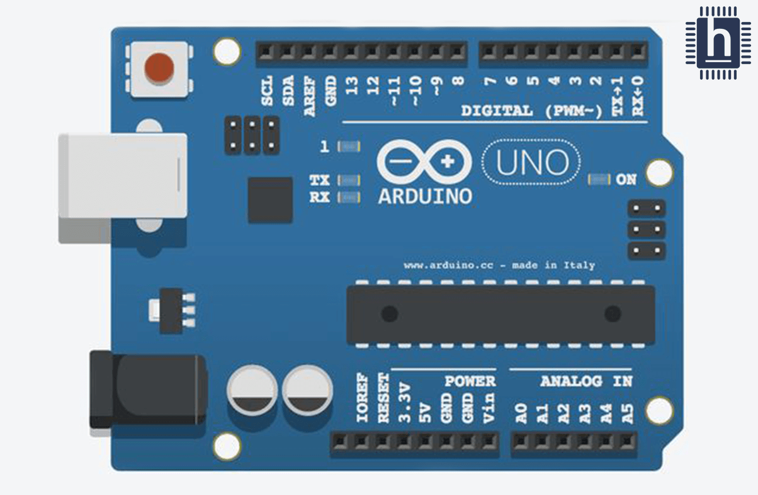
UNO Board
Present by Phyo Aung

Slide 2
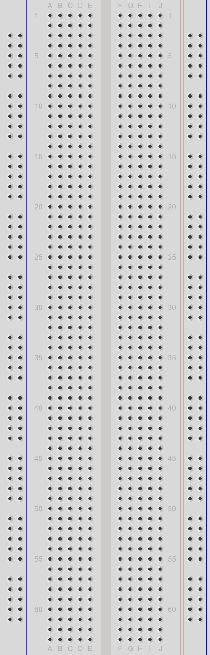
Line
Vertical
Ground
Horizontal
Notes:
Breadboard ကို Electronic Circuit တိတည်ဆောက်ဖို့နဲ့ ပုံတူပုံစံတူတိလုပ်ဖို့အတွက်သုံး
ဂဟေဆော်ပြီးသုံးစရာမလိုတဲ့အတွက် Porject တိစမ်းတဲ့အချိန်မာအသုံးဝင်
Breadboard နဲ့ UNO boardကို Jumper လို့ခေါ်တဲ့ Wire ကြိုးတိနဲ့ဆက်ရရေ

Slide 3
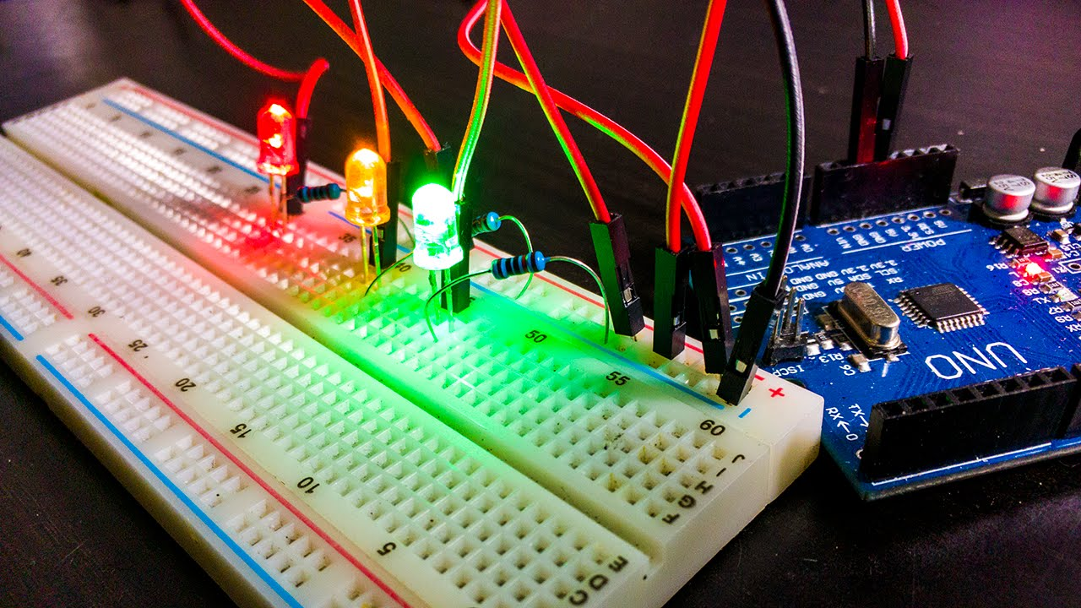

Slide 4
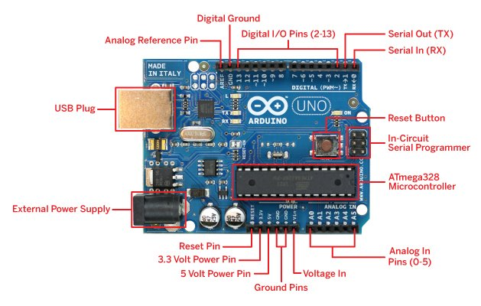
Components of UNO Board
Notes:
RX and TX is use for Bluetooth Device

Slide 5
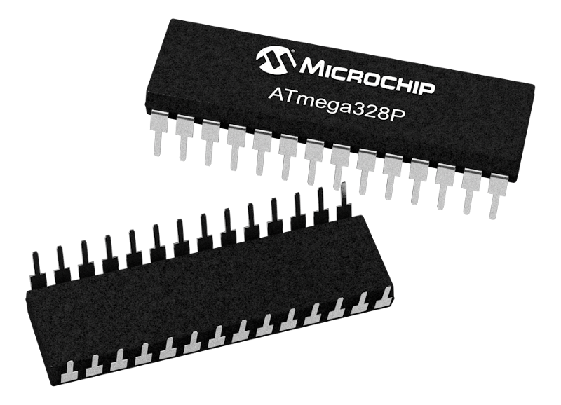
Microcontroller

Slide 6
Microcontroller
A microcontroller is a small computer system on a single integrated circuit chip. It contains a processor core, memory, and various input/output peripherals, such as timers, serial communication ports, and analog-to-digital converters. Microcontrollers are designed to be used in embedded systems, where they control the operation of devices or machines.
Microcontrollers are used in a wide range of applications, including automotive systems, home appliances, medical devices, consumer electronics, and industrial automation. They are often programmed in low-level programming languages, such as C or assembly language, and are used to implement control algorithms, data acquisition, and communication protocols.
Some common microcontroller families include the Atmel AVR, Microchip PIC, and ARM Cortex-M. Microcontrollers come in a variety of sizes and processing power, from tiny devices with only a few kilobytes of memory to powerful microcontrollers with many megabytes of memory and advanced features like real-time operating systems and hardware encryption.
Notes:
Microcontroller is a small computer system
Low Power / High Performance (8-bits) Type
32KB Flash Memory for storing code (Sketch prgoramကိုသိမ်းထားပေး, Non-volatile)
2KB SRAM for data storage (volatile)
1KB EEPROM (non-volatile ) [Electrically Erasable Programmable Read-Only Memory]
Microcontroller has 16MHz quartz crystal oscillator and it support clock signal to microcontroller
Clock Signal ကို Microcontroller နဲ့ အရံပစ္စည်းတိကိုတစ်ပြိုင်တည်းလုပ်ဆောင်ပေးဖို့သုံး
Red Bold Text ကိုပြော
Volatile = RAM
non-Volatile = ROM

Slide 7
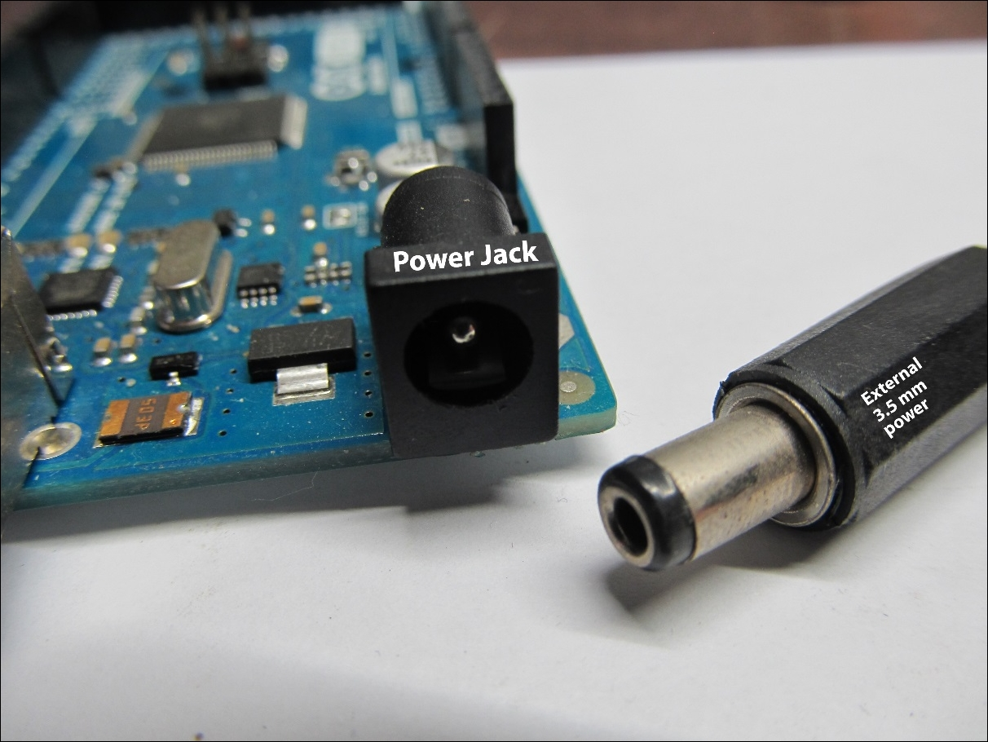
Power Jack

Slide 8
Power Jack
The power jack on the Arduino Uno board is used to connect an external power source to the board. When an external power source, such as a battery or a wall adapter, is connected to the power jack, it can be used to power the board without the need for a computer or USB connection.
The power jack on the Arduino Uno board accepts a 5V DC power supply. When a power supply is connected, it passes through a voltage regulator on the board that regulates the voltage to a steady 5V, which is then used to power the microcontroller and other components on the board.
Notes:
-Power Jack ကို external porer source တိနက်ချိတ်ဆက်ဖို့သုံး
-Batter , Adapter ရို့ပိုင်power source တိနက်ချိတ်ဆက်လိုက်တဲ့အခါ Computer/usb နဲ့ချိတ်စရာမလိုဘဲ Uno board ကိုpower ပေးနိုင်
-Power Jack 7V to 12V DC only support
-Power jack ကနေတဆင့် Microcontroller နဲ့အခြာသောအစိတ်အပိုင်းတိသို့Power ပို့ပေး

Slide 9
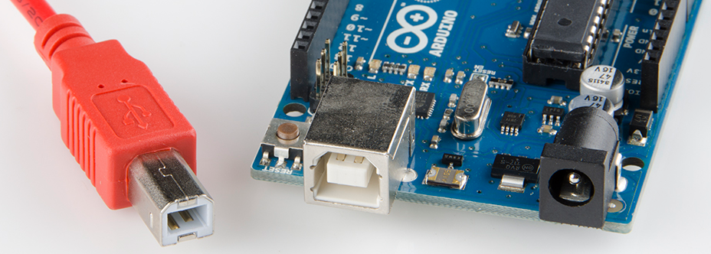
USB Connector

Slide 10
USB Connector
Uploading Code: The USB connector allows you to upload code to the Arduino Uno board from your computer. By connecting the board to your computer via USB, you can use the Arduino Integrated Development Environment (IDE) to write and upload code to the board.
Powering the Board: When the Uno board is connected to a computer via USB, it can be powered directly from the computer's USB port. This is a convenient way to power the board when you're working with it on your desk or bench.
Serial Communication: The USB connector on the UNO board also provides a serial communication interface between the board and your computer. This allows you to send and receive data between the board and your computer, which can be useful in a wide range of applications.

Slide 11
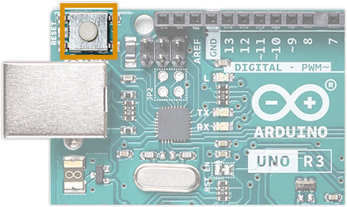
The Reset button

Slide 12
The Reset button
The Reset button on the Arduino Uno board is a physical button that can be used to reset the microcontroller on the board. When the button is pressed, it causes the microcontroller to restart and begin executing its program from the beginning.
Uploading New Code: When you upload a new program to the Arduino Uno board, you can use the Reset button to trigger the reset, allowing the new program to be uploaded and executed.
Restarting the Program: If your program gets stuck or stops running for some reason, you can use the Reset button to restart the program from the beginning.
Notes:
-Does not erase Data
-Only Restart the setup() Function

Slide 13
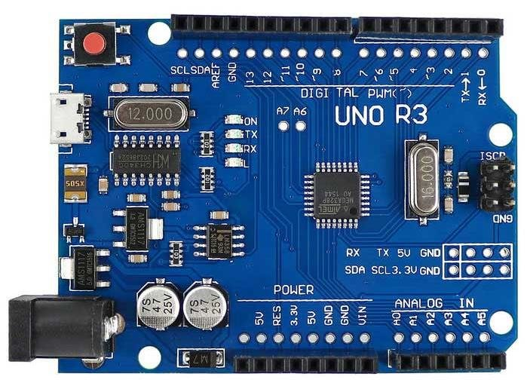
Reset Pin

Slide 14
Reset Pin
The reset pin on the Arduino Uno board is a physical pin that can be used to reset the microcontroller on the board. When the reset pin is connected to ground, it causes the microcontroller to restart and begin executing its program from the beginning.
Uploading New Code: When you upload a new program to the Arduino Uno board, the microcontroller needs to be reset in order to start running the new program. The reset pin can be used to trigger this reset, allowing the new program to be uploaded and executed.
Restarting the Program: If your program gets stuck or stops running for some reason, you can use the reset pin to restart the program from the beginning.

Slide 15
Power Pin and Ground Pin

Slide 16
Power Pin and Ground Pin
Vin: This pin is used to power the Arduino board using an external power source such as a battery or a power supply. The voltage range for Vin pin is between 7V to 12V.
5V: This pin provides a regulated 5V DC output from the Arduino board. You can use this pin to power external sensors or modules that require a 5V power supply.
3.3V: This pin provides a regulated 3.3V DC output from the Arduino board. You can use this pin to power external sensors or modules that require a 3.3V power supply.
GND: These pins are connected to the ground and are used as the reference point for all the electrical circuits on the Arduino board.

Slide 17
Analog In Pin (0-5)

Slide 18
Analog In Pin (0-5)
In Arduino Uno board, the analog pins (labeled A0 to A5) can be used to read analog signals. These pins can read voltage values between 0 and 5 volts and convert them into a digital value using an Analog-to-Digital Converter (ADC).
Analog pins can be used in a variety of applications, including:
Reading values from analog sensors such as temperature sensors, light sensors, potentiometers, and other analog sensors.
Measuring the voltage of a battery or power supply.
Controlling the brightness of an LED using Pulse-Width Modulation (PWM).
Creating custom waveforms for audio or other applications.
Interfacing with other analog circuits or devices.
*To use an analog pin in your Arduino sketch, you can use the analogRead() function.

Slide 19
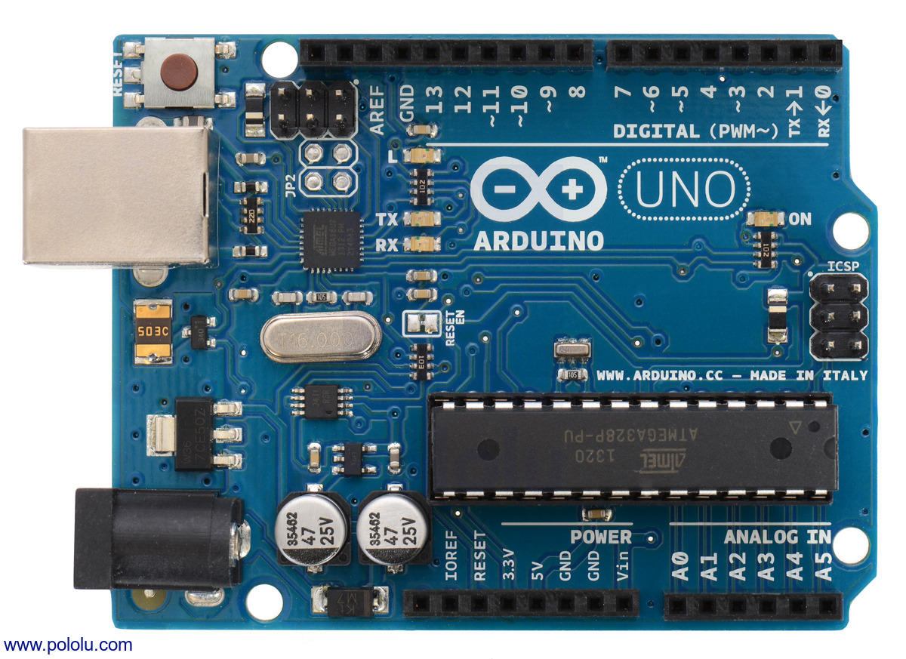
Digital I/O Pins(2-13)

Slide 20
Digital I/O Pins(2-13)
In Arduino Uno board, digital I/O pins can be used for both input and output operations. These pins can be configured as either inputs or outputs using the pinMode() function in your Arduino sketch.
Digital I/O pins can be used in a variety of applications, including:
Controlling the state of an LED or other digital output device.
Reading the state of a switch or other digital input device.
Driving motors or other actuators using a digital signal.
Communicating with other digital circuits or devices using protocols such as SPI, I2C, or UART.
To use a digital pin in your Arduino sketch, you can use the digitalWrite() and digitalRead() functions. The digitalWrite() function is used to set the state of a digital output pin, while the digitalRead() function is used to read the state of a digital input pin

Slide 21



